Slide 1
Covid-19
Supervised: Prof. Osama fathy
TA: Eng. Ola Mahmoud
Name: ahmed Yasser ahmed
Id: 20213939
GROUP: C5.2

Slide 2
Agenda
Introduction
Analysis of the Project
Identification Problem
Decision Tree
Production Rules
Object Attribute Value (OAV)
Semantic Network
Frames
Project Implementation Code
Conclusion
References

Slide 3
Introduction
The COVID-19 pandemic has posed a global health crisis, making early detection and risk evaluation crucial. Our project introduces a COVID-19 Expert System developed using Python and the experta rule-based library. It simulates a diagnostic consultation by asking a series of structured questions based on the user's symptoms, age, and medical history. The goal is to provide a basic risk level assessment and advise the user accordingly. This type of system demonstrates how expert systems can assist in medical triage and reduce the burden on healthcare systems.

Slide 4
Analysis of the Project
The project was implemented using the experta library, a Python framework for building expert systems using the CLIPS rule-based paradigm. The system includes eight diagnostic levels, each with 3 questions, totaling 24 inputs.
Each level gathers specific information:
Levels 1–4: Focus on symptoms such as fever, cough, and loss of taste/smell.
Levels 5–6: Target risk factors including age and pre-existing conditions.
Levels 7–8: Analyze the duration and severity of symptoms and exposure history.

Slide 5
Identification Problem
Attribute/Type | Low Risk | Moderate Risk | High Risk
General Symptoms | Moderate | Moderate | High
Breathing and Chest Symptoms | Sometimes | Often | Always
Sensory Symptoms | No | Rare | Severe
Pain and Aches Symptoms | Slight | Moderate | Always
Digestive Symptoms | Mild | Moderate | Severe
Mental Symptoms | No | Sometimes | Often
Pre-existing Conditions | Controlled | Uncontrolled | Severe
Risk Factors | No | Moderate | High

Slide 6
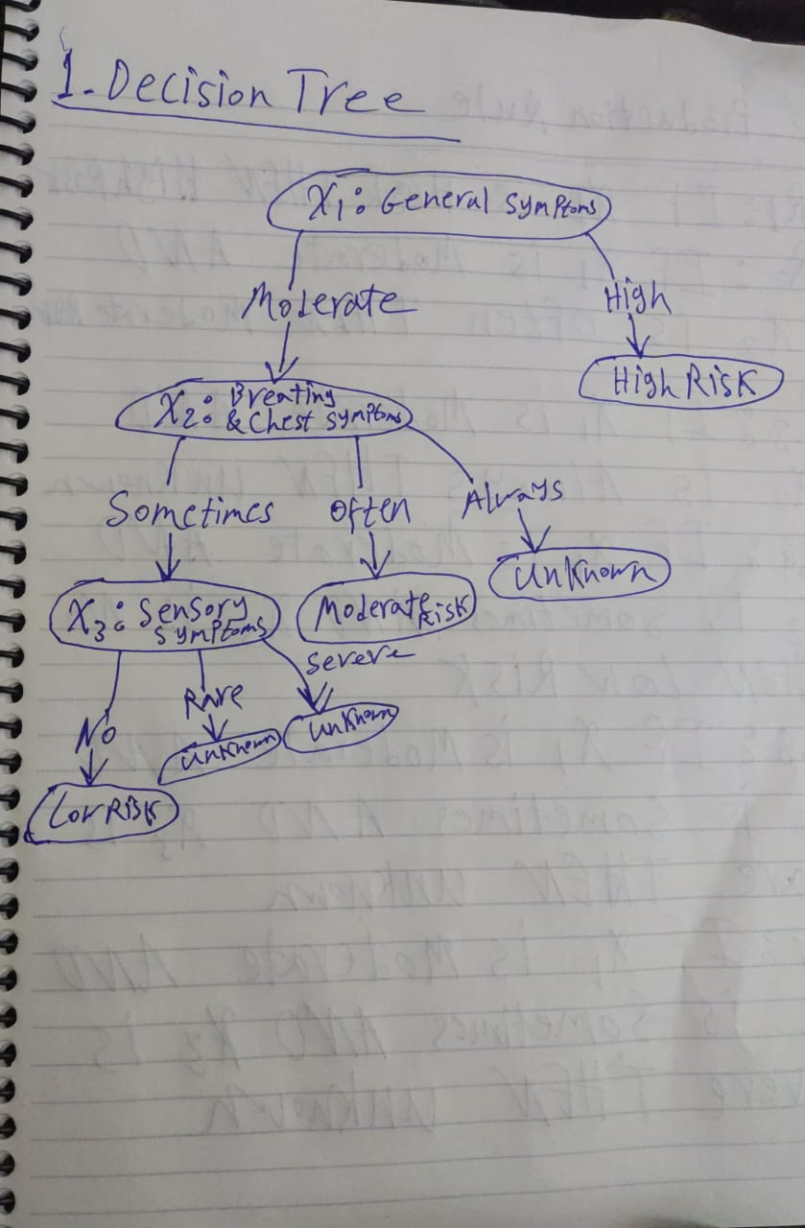
Decision Tree

Slide 7
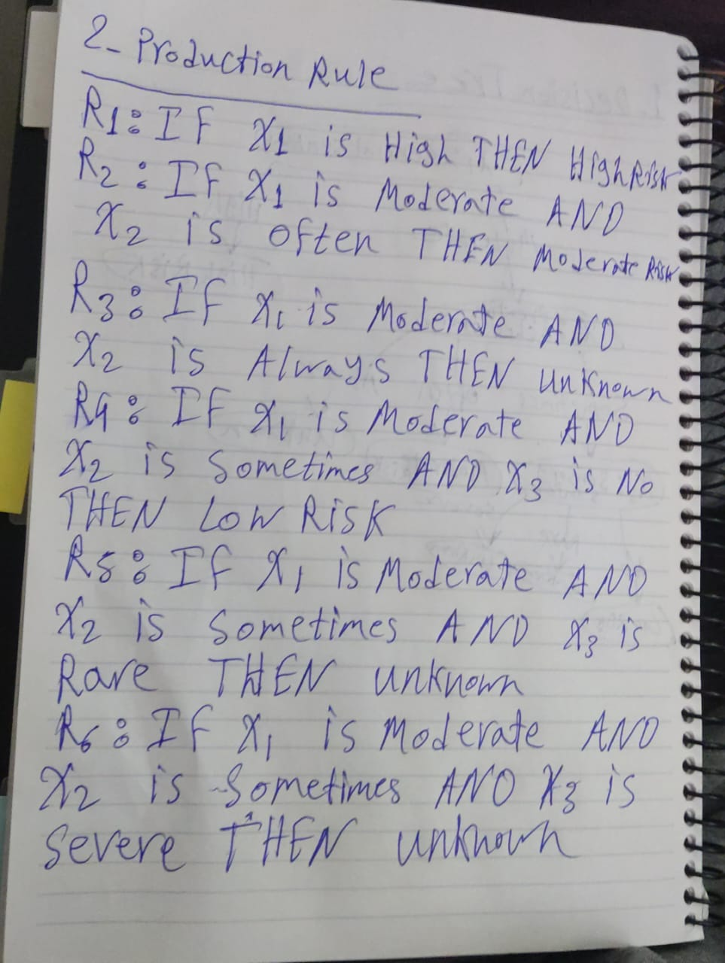
Production Rules

Slide 8
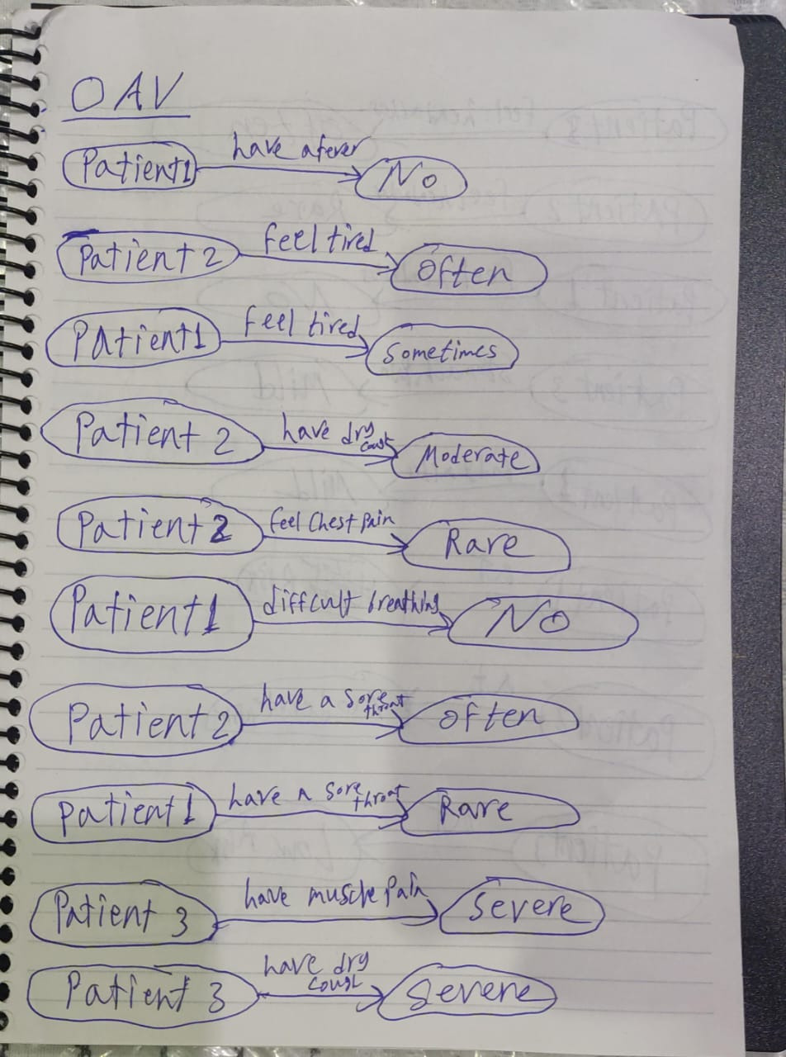
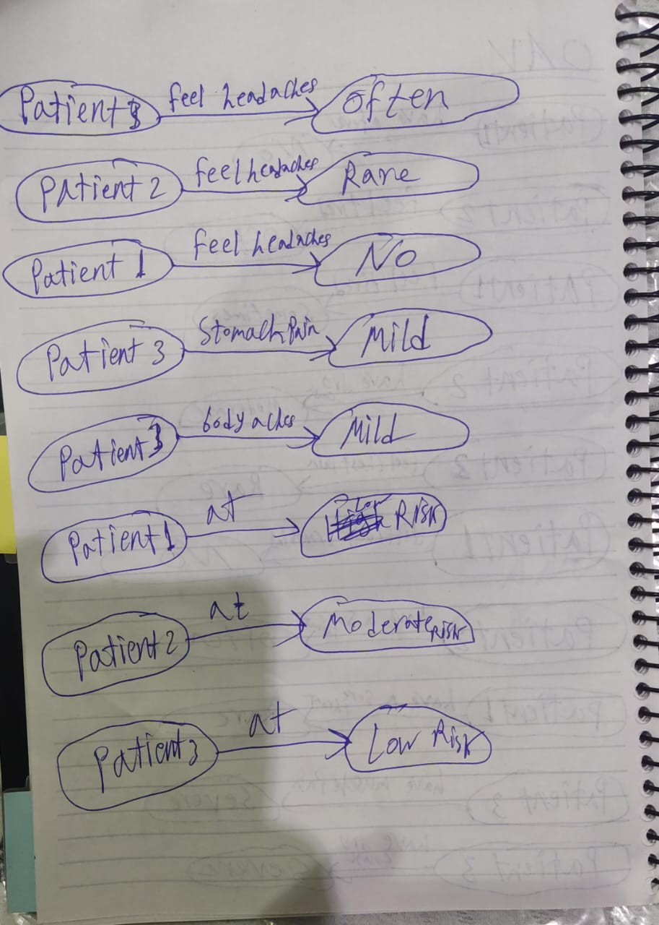
Object Attribute Value (OAV)

Slide 9
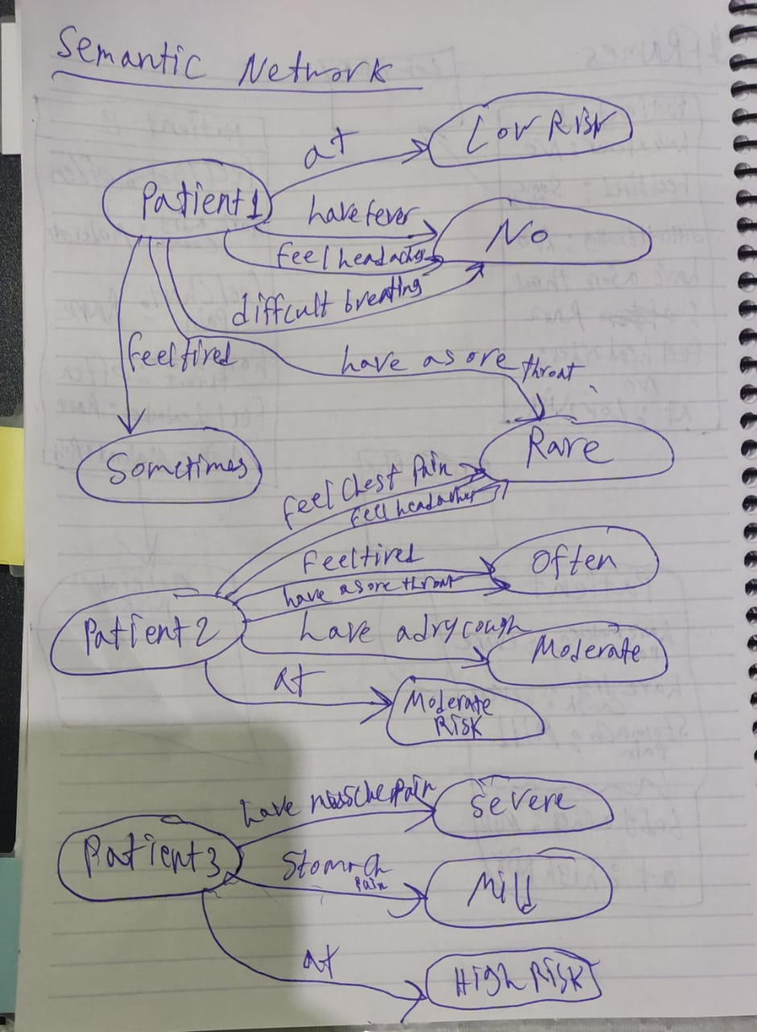
Semantic Network

Slide 10
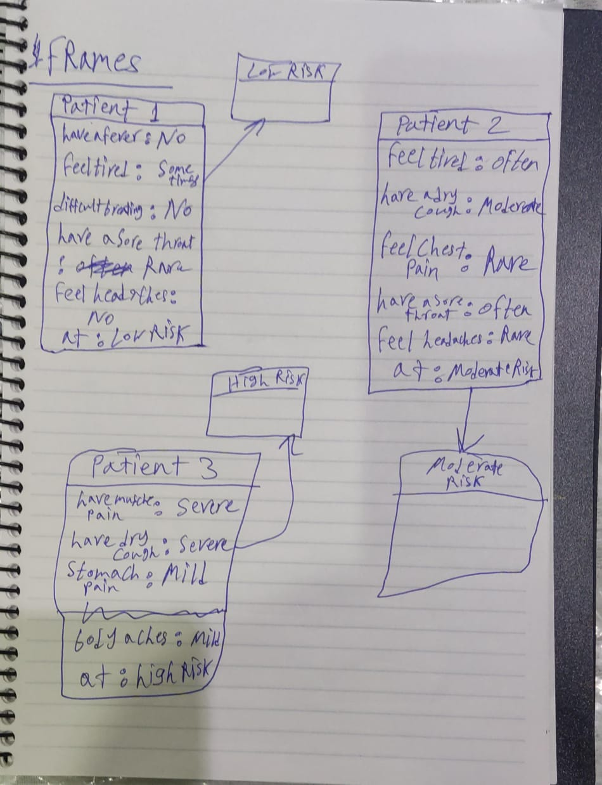
Frames

Slide 11
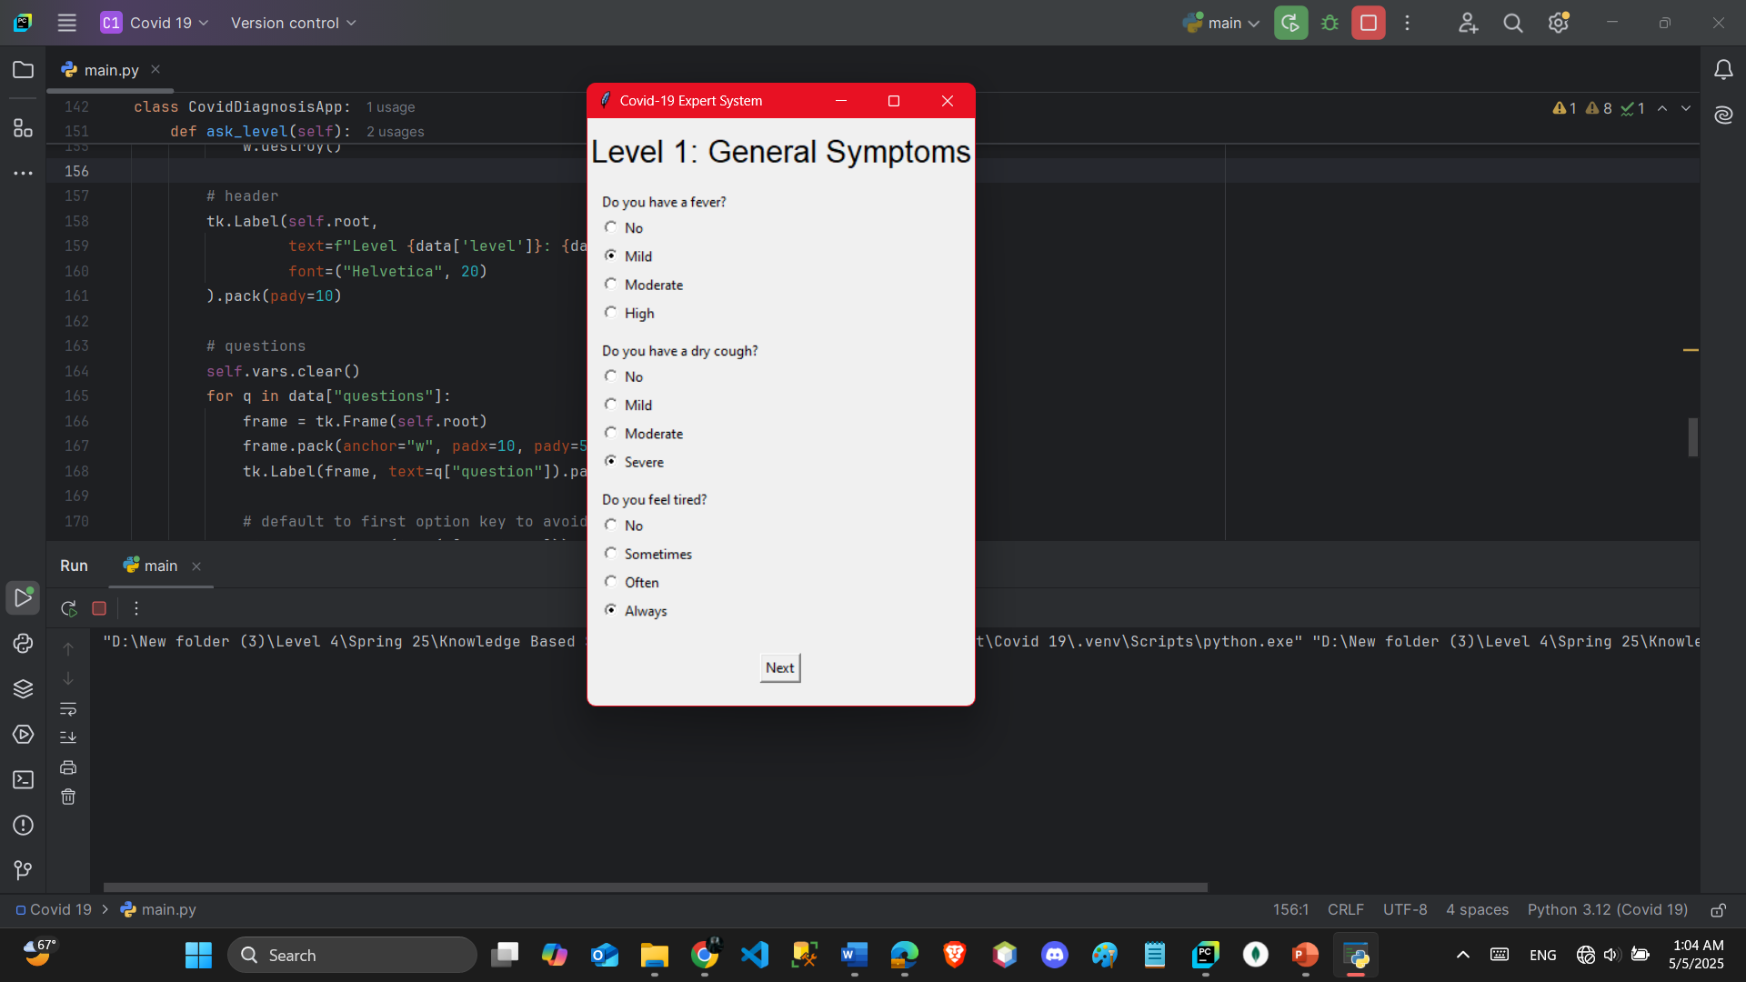
Project Implementation Code

Slide 12
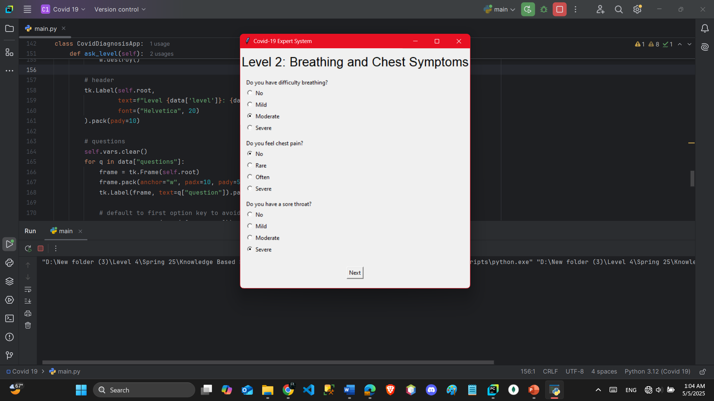
Project Implementation Code

Slide 13

Project Implementation Code

Slide 14
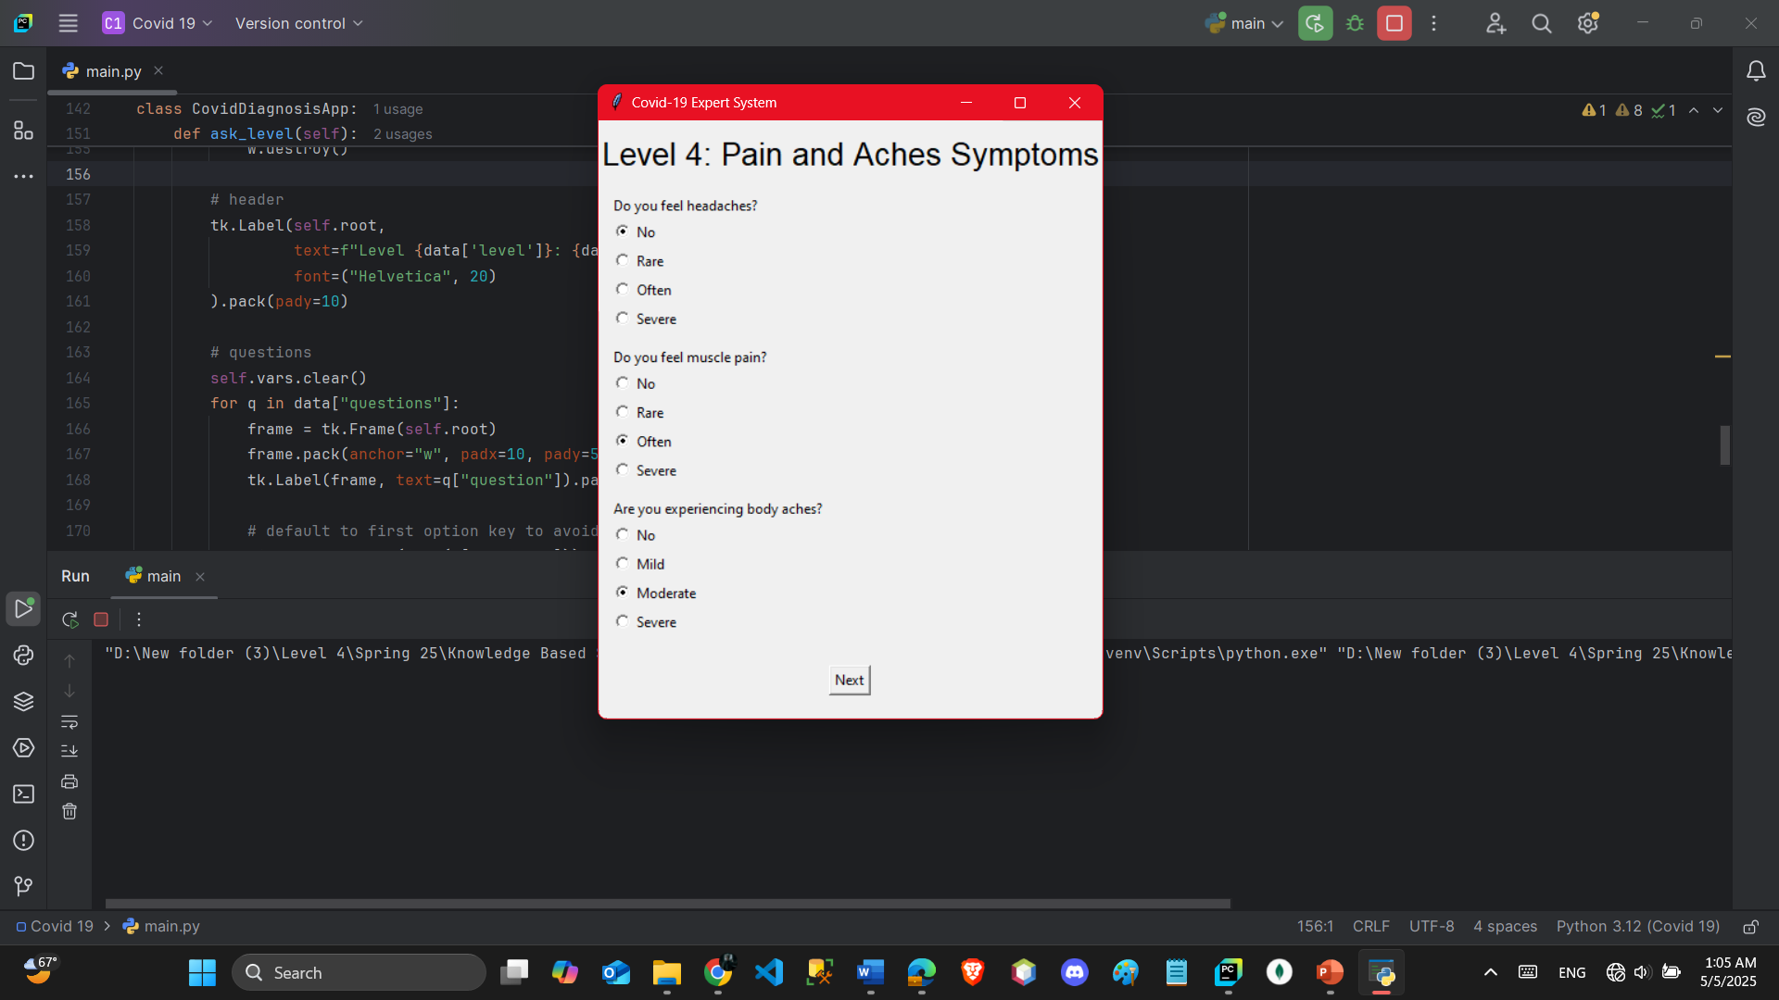
Project Implementation Code

Slide 15

Project Implementation Code

Slide 16

Project Implementation Code

Slide 17
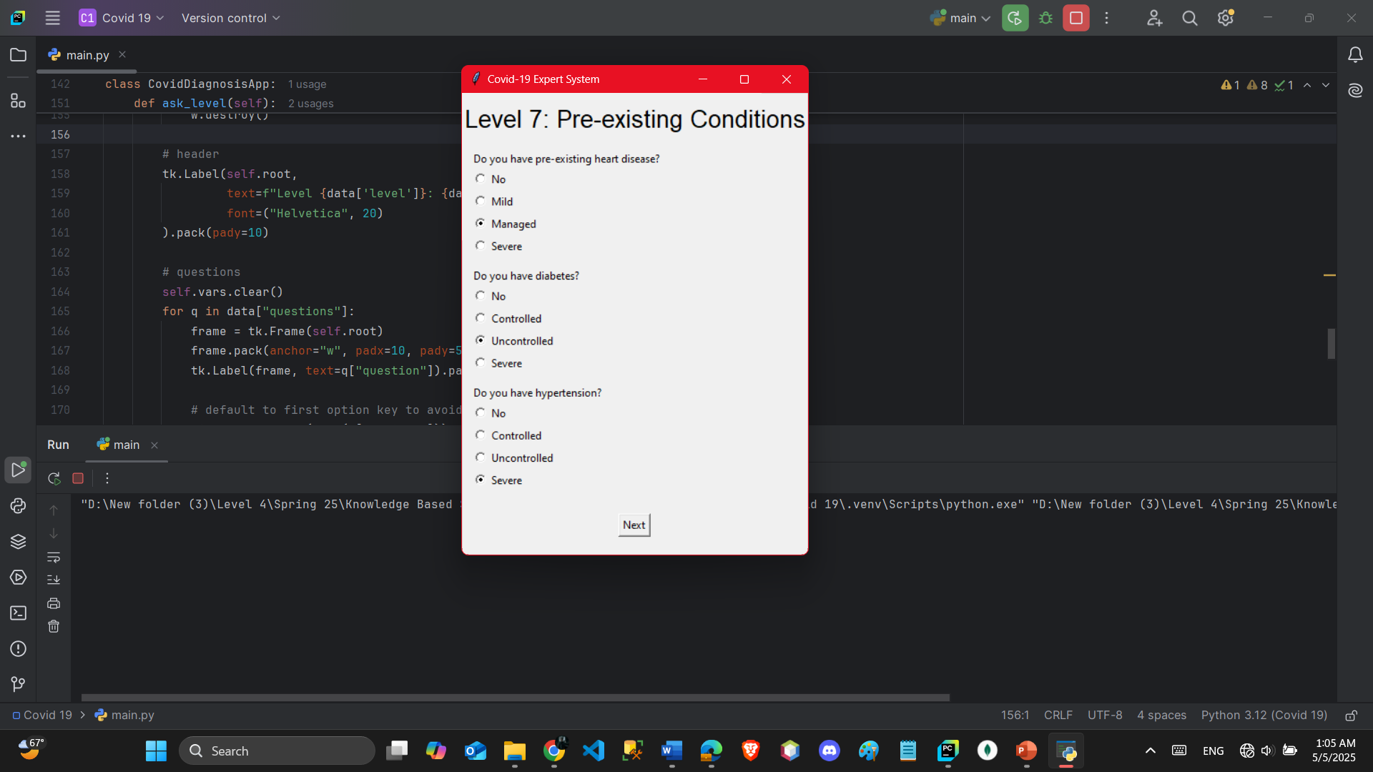
Project Implementation Code

Slide 18
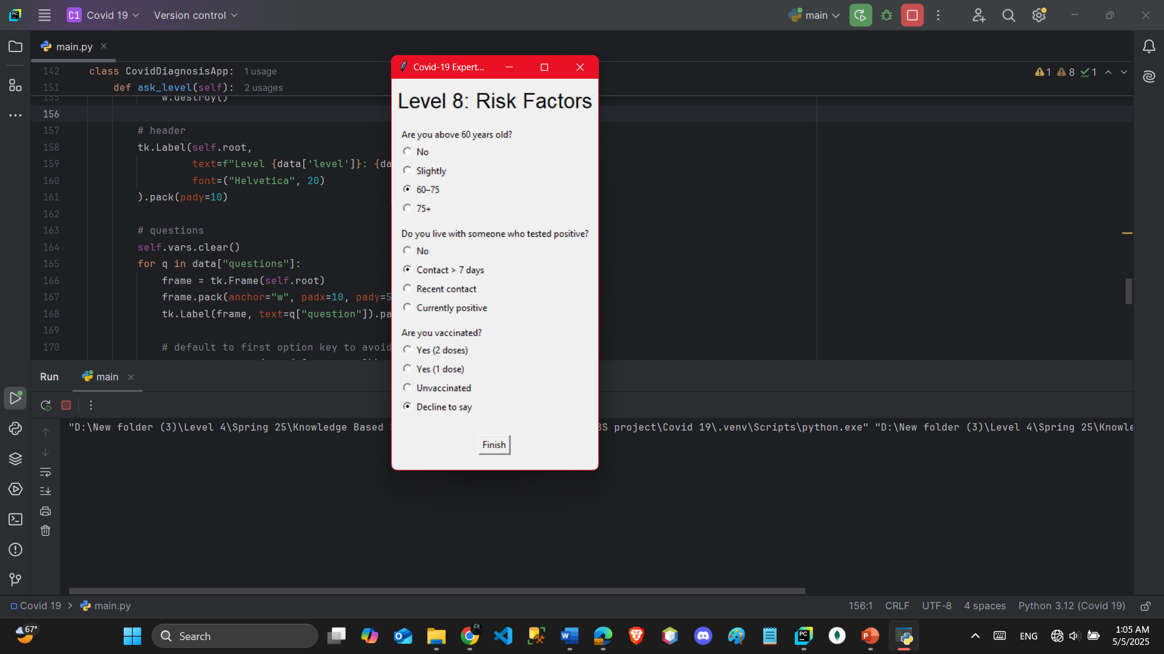
Project Implementation Code

Slide 19
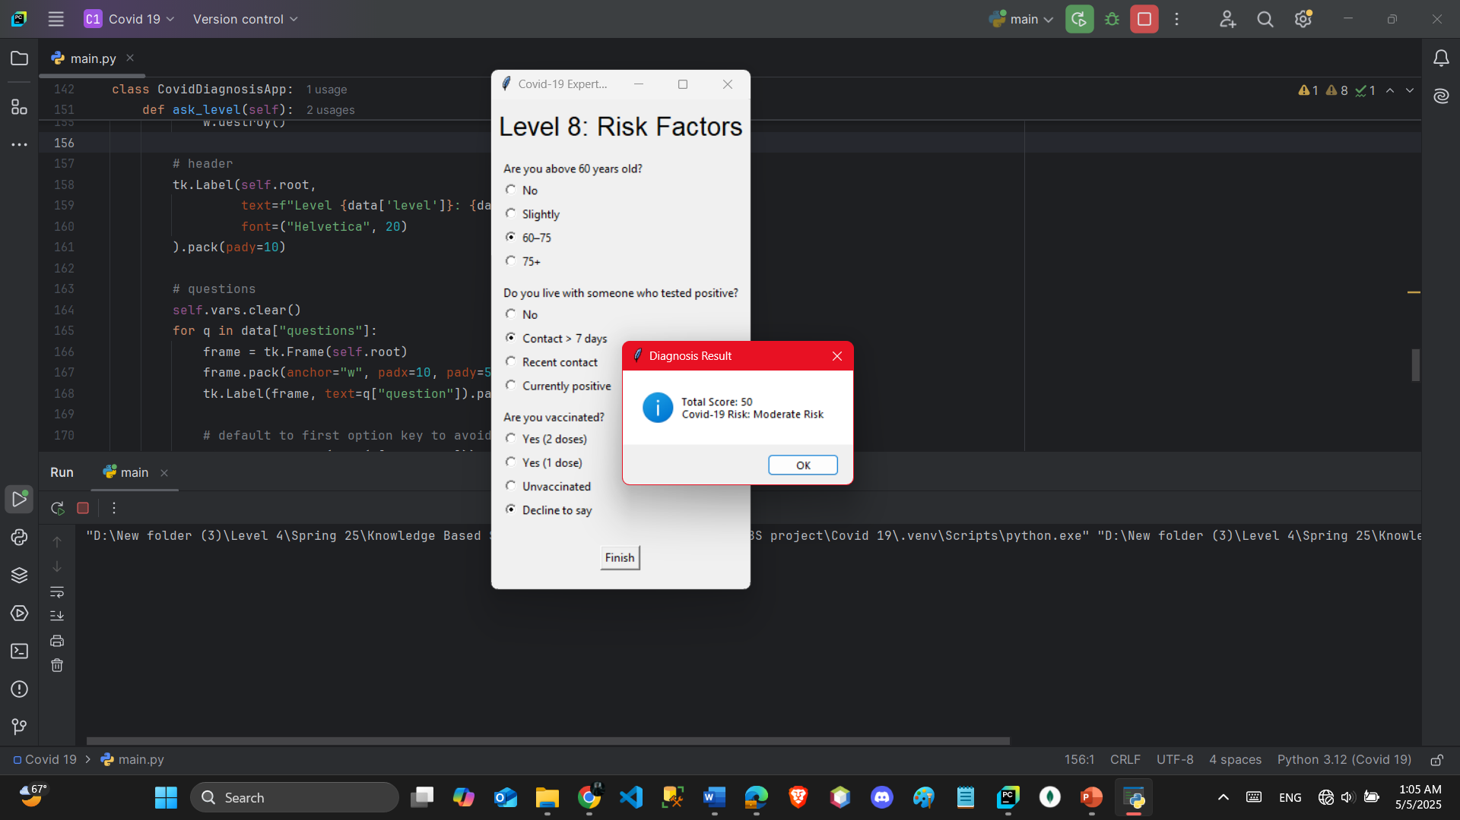
Project Implementation Code

Slide 20
Conclusion
The COVID-19 Expert System demonstrates the effectiveness of rule-based systems in medical diagnostics. While it cannot replace real testing, it serves as a preliminary tool for assessing COVID-19 risk. It showcases the use of AI in healthcare, emphasizing transparency in decision-making via logical rules and structured questioning.
This project also strengthened our understanding of knowledge representation models, inference engines, and user interaction design.

Slide 21
References
–, P. O. (n.d.). Retrieved from https://docs.python.org/
Documentation, E. L. (n.d.). Experta Library Documentation.
Retrieved from Experta Library Documentation: Experta Library Documentation
Factors, C. –S. (n.d.).
Guidelines, W. H.–C.-1. (n.d.).
Norvig, A. I. (n.d.). Artificial Intelligence: A Modern Approach. In b. S. Norvig.

Slide 22
Thanks

